Slide 1
Design your style
YOUR DESIGN
YOUR FASHION
By:
Eeti Jain(11bce027)
Kavya Jha(11bce041)
Yamini Rathod(11bce078)

Slide 2
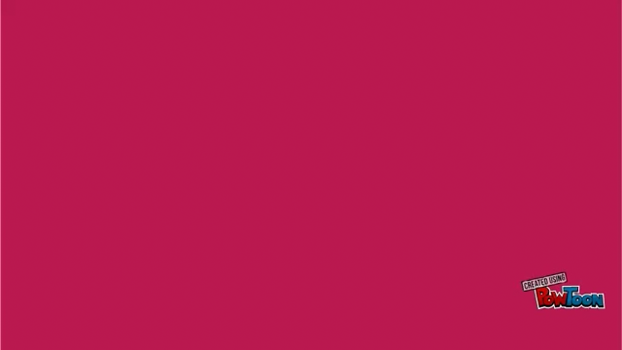

Slide 3
About us
A portal where you can DESIGN YOUR OWN dress and see how it looks.
Designing includes Selection of fabrics and Cloth pattern, which you LIKE.
Also you can shop the Readymade Dresses or the dresses designed by other customers.
You finalize the design, We STITCH and DELIVER !!

Slide 4
OTHER SITES
Sites such as “koovs.com” , “ebay.com” , “shopperstop.com”, “flipkart.com”, “amazon.in” and many other online shopping sites.
They provide, You choose.
THEN, HOW ARE WE DIFFERENT?

Slide 5
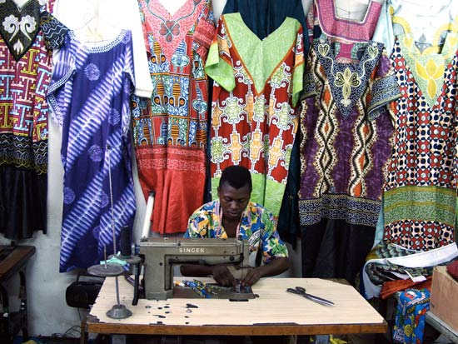

Your design, your choice
We provide you the opportunity to design your dresses.
We show you how it looks.
No TAILOR jhanjhat!!

Slide 6
Product Scope
Login And Registration
Ongoing activities and Personal Cart to customer
Shop readymade Dress
Stitching Module
Payment and Delivery options

Slide 7
Literature review
Various Shopping websites such as Flipkart, fabindia, amazon, etc. No one provide Customizing feature of the dress.
creyate. com provides customization of shirts. No website yet that do this for women dresses.
Further, Selection between two shopping cart solution:-
Magento
Prestashop

Slide 8
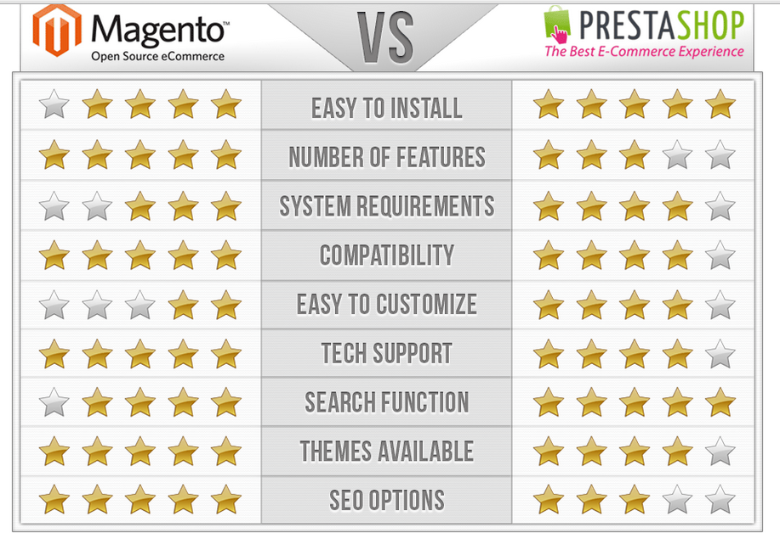
Magento v/s prestashop

Slide 9
Both are open Source Softwares.
PrestaShop gives tons of features, makes site management easy, provides SEO benefits, gives users analytics and reporting , which makes finding help with the program easy.
Magento is, however, known as the leader in eCommerce shopping cart solutions. They provide a huge variety of features, tools and customization. Magento provides better SEO benefits than any other shopping cart on the market with targeted promotion and merchandising.
They also allow for multiple payment and shipping option.

Slide 10
Implementation
Tools Used:-
WAMP Server
Prestashop
Adobe flash
Adobe Photoshop

Slide 11
WAMP Server
Windows Apache MySQL PHP
It is a Windows Web development Environment for personal webhosting.
It allows one to create webs applications using Apache2, PHP and MySQL Database.
Alongside, PHPMyAdmin allows to manage our databases easily.
Apache is used to run the web server within windows.
MySQL is a high speed database while PHP is a scripting language that can be used to access data from the database.
Functionalities of WAMP Server:-
Managing server settings
Accessing and managing logs
Storing and managing Databases
Switching online or offline i.e. giving access to everyone or only local host
Server side scripting using PHP for transferring data

Slide 12
prestashop
It is a free, open source e-commerce solution.
The modules provided by Prestashop are written in PHP and based on the Smarty template engine.
It provides with various built in features including unlimited product inventory management, layered navigation, analytics and reporting, unlimited currencies and return management.
The various modules are linked together to form a website, which is done by running PHP and JavaScript's on WAMP server and providing appropriate links.
There are various Front-office and back-end features.

Slide 13
Front Office Features :
Feature Products(Top seller, new items, ...) on the homepage
Build-in product-image zoom
Customer subscription and user accounts
Unlimited payment methods
RSS Feeds
Back Office Features:
Unlimited categories and subcategories
Different currency settings and tax settings
Customizable delivery status and notification
SSL encryption
Smarty Templating Engine

Slide 14
Adobe flash cs6
It is a multimedia authoring program used to create content such as web applications, games and movies, and content for mobile phones and other embedded devices.
Used to add interacting multimedia content to web pages.
It can capture user input via mouse keyboard microphone and camera.
Flash applications and animation can be programmed using the object oriented language called Action Script.
In our project Flash is used to develop the stitching module.

Slide 15
Adobe Photoshop cs6
It is a raster graphics editor developed and published by Adobe System for Windows.
It can edit and compose rater images in multiple layers and supports masks and several color models.
It has limited abilities to edit or render text, vector graphics, 3D graphics and video.
It can be used for cropping images, compositing ghosting images using layers, creating masks, applying filters and formatting text with effects.

Slide 16
Our work flow
Shop Readymade
Choose Design
Submit
Fashion Style Clothing
Design your dress
Choose Fabric
Stitching Module
Final Submit
Login
Sign Up

Slide 17
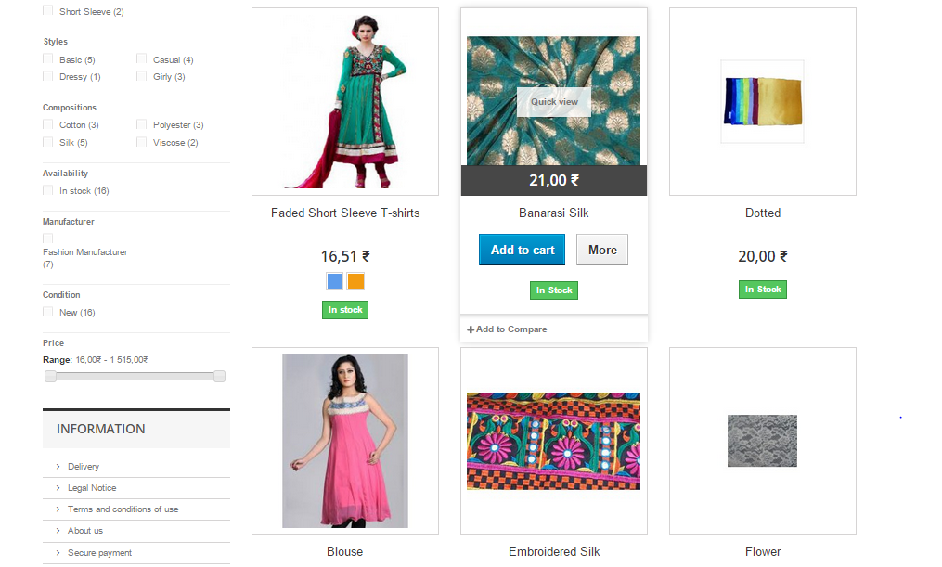
Shopping module
Showcases the readymade designs sold by the company and adds them to the cart when selected.
Products can be categorized according to various filters and also can be displayed according to most popular or best sellers

Slide 18
Stitching module
It guides the user through simple steps how to design her own dresses.
The first step is to choose from the variety of fabrics provided to design the dress.
After selecting the fabric the user is asked to either add that fabric to the cart or design the dress using it.
Module is made up of multiple swf files linked together.

Slide 19
Stitching Module
Select the fabric
Select the style of Kurti selected
Select the appropriate neck pattern
Submit- will save image in the database
Select the Sleeve pattern

Slide 20
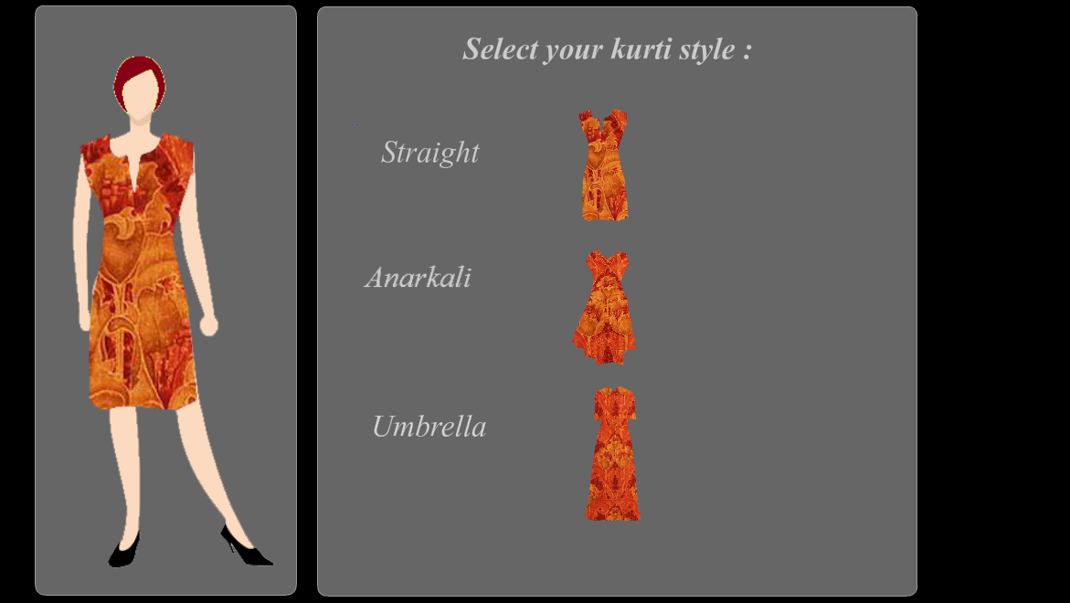
Selecting Kurti Style

Slide 21
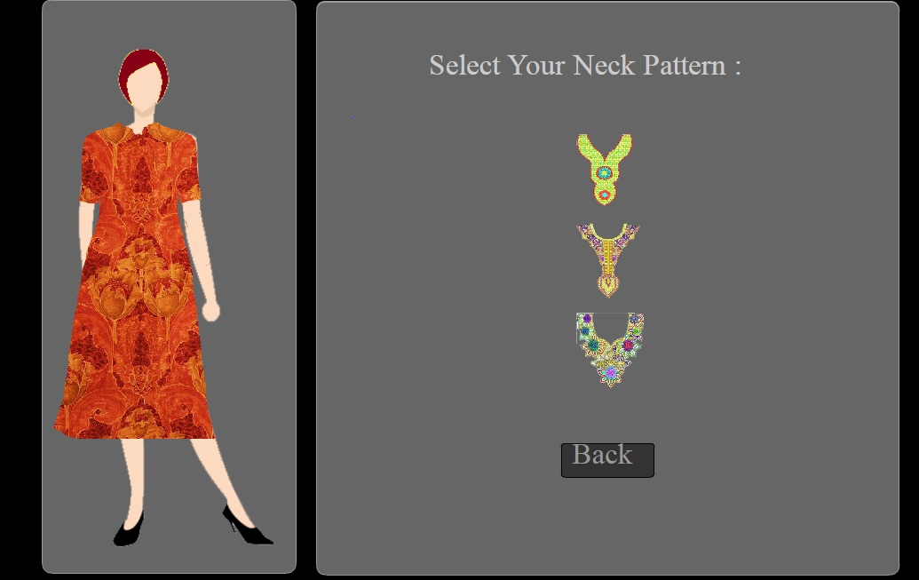
Selecting Neck pattern

Slide 22
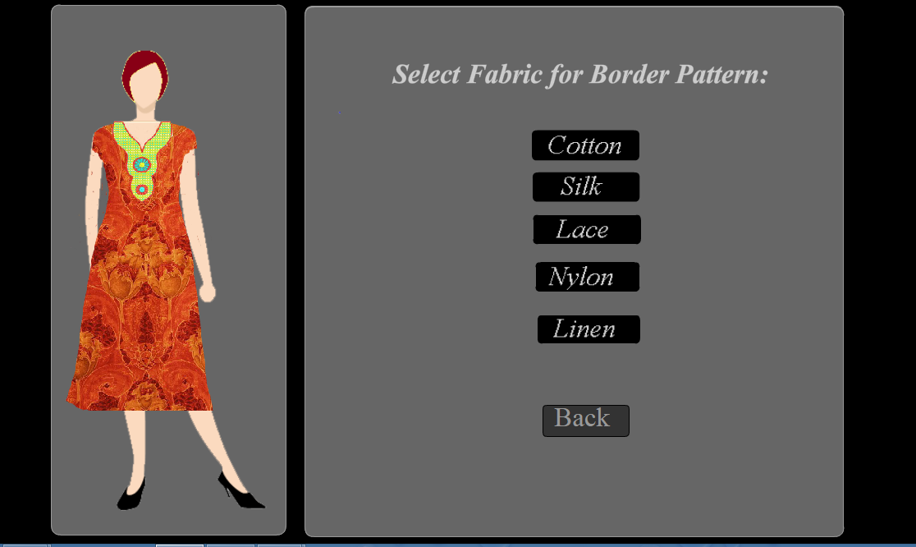
Selecting cloth for border pattern

Slide 23
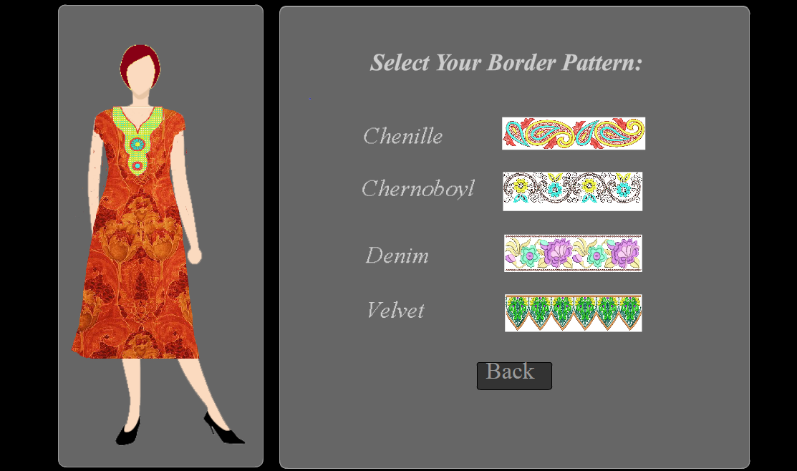
Select border pattern

Slide 24
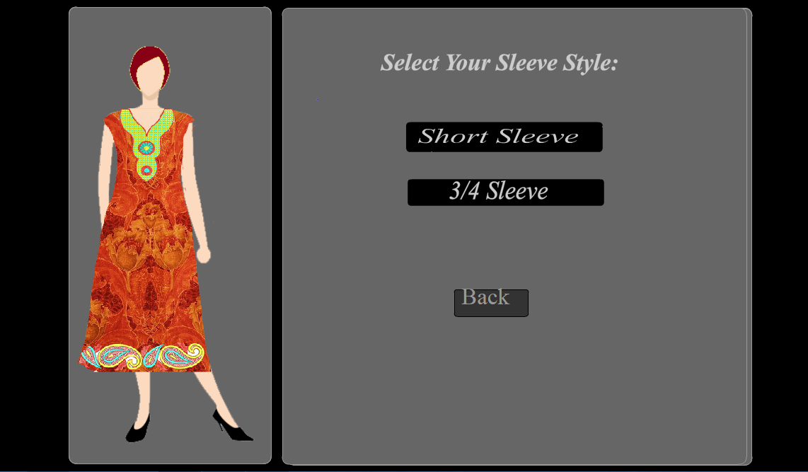
Select sleeve style

Slide 25
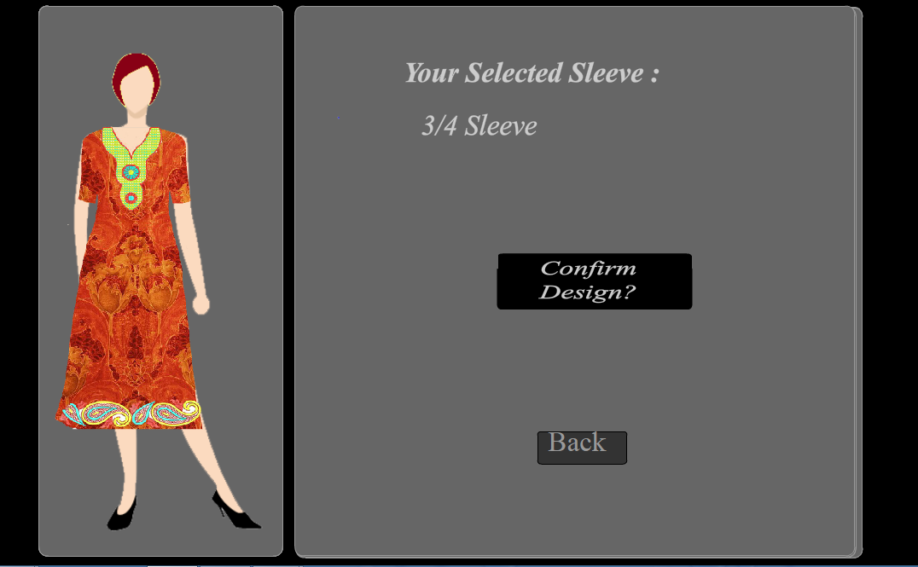
Confirm the Design

Slide 26
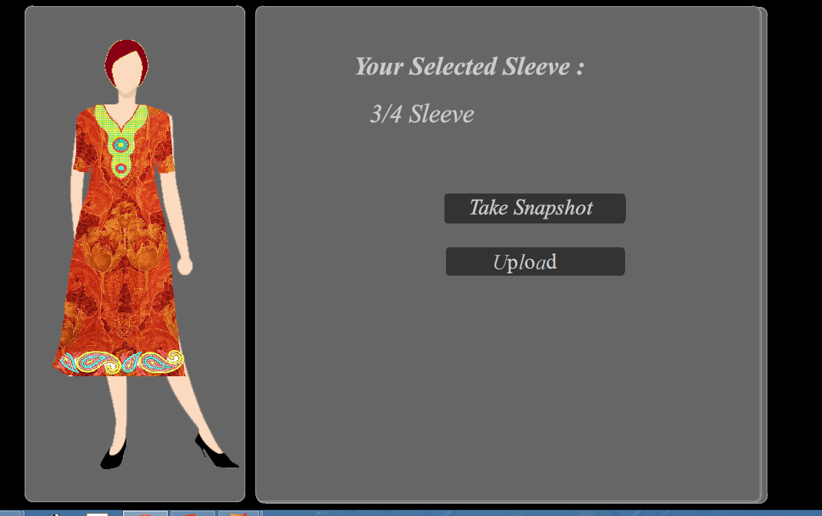
Take snapshot and upload the image

Slide 27
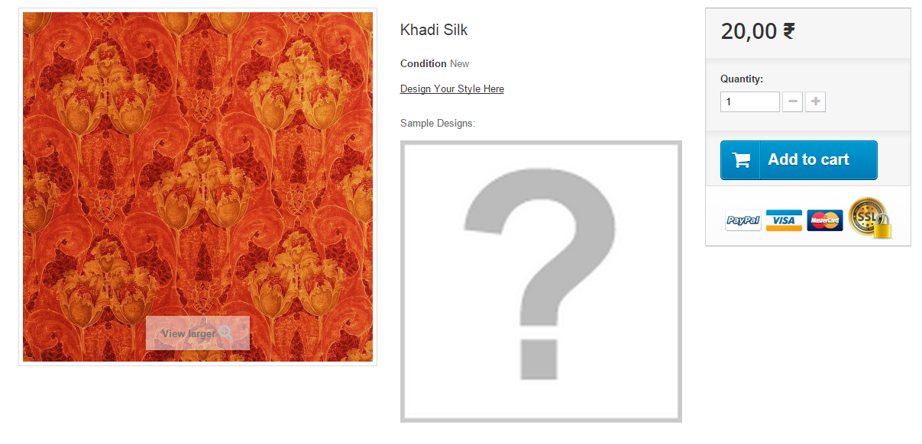
Sample design not shown

Slide 28
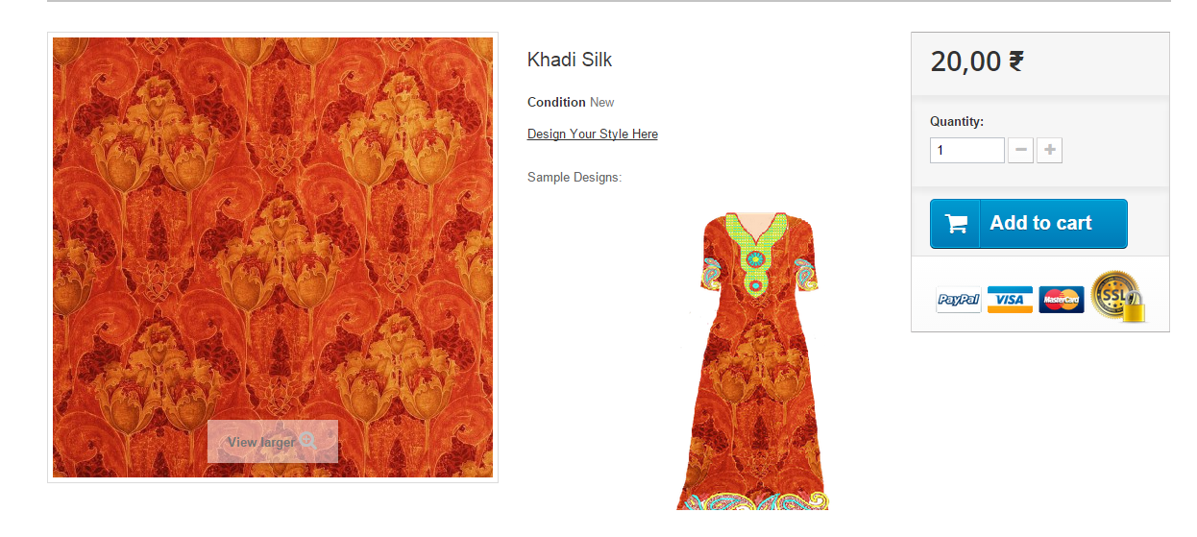
Sample design shown after upload

Slide 29
Login module
Login is compulsory before making a payment and final submission of the order.
Once the user creates an account, his details are saved in a database along with his home address.
The personal information saved are confidential and can only be accessed by the user or the admin itself.
The first time users have to Sign up in order to create an account and place orders.

Slide 30
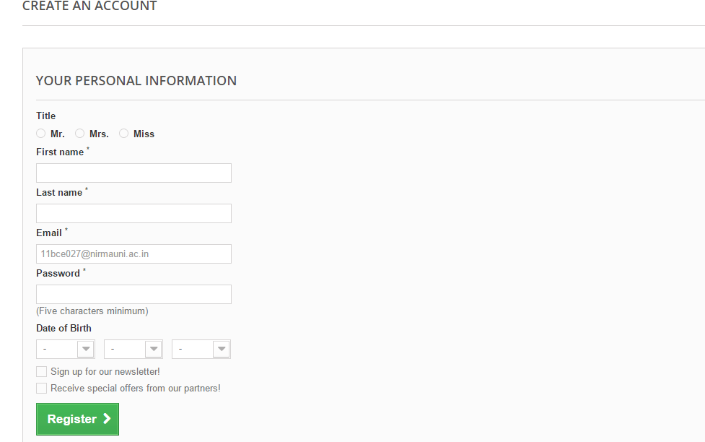
Creating an account

Slide 31
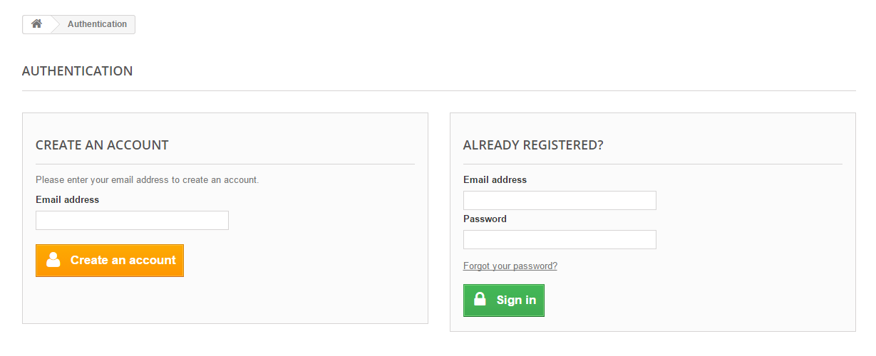
Login page

Slide 32
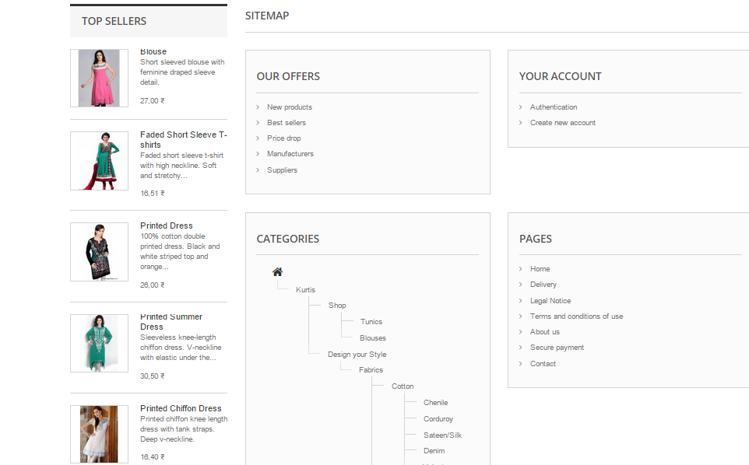
miscellaneous
Mailing Facility
Newsletter
New Products
Best Sellers
Special Offers
Sitemap

Slide 33
Results
The result of this minor project is an almost completed portal which provides the facility to shop the Indian Kurtis and ,where one can design the type of dress one likes to wear.
It also provides the facility of seeing the designed dresses on dummy for getting the sense of how it actually looks after stitching. Thus ensuring the design your style concept of the portal
Fashion Style Clothing!!!

Slide 34
conclusion
Implementing the type of functionalities done for only one design, if be implemented for numerous design present, then it can be a successful portal on web where everyone from Fashion Designers, fashion freaks to normal users who want to change their dressing style with the change in fashion or who just want to shop something new will think of only one stop that is Fashion Style Clothing.

Slide 35
Future scope
In the future, this portal can be completed by integrating final result of new designed data with the payment module, where money of various objects that is included in the product design is counted for the final payment of the ordered design.
Further, currently this portal is working for only one sample design but it can be furnished so as to include multiple designs.

Slide 36
Thank you

